Slide 1
Unsupervised Clustering

Slide 2
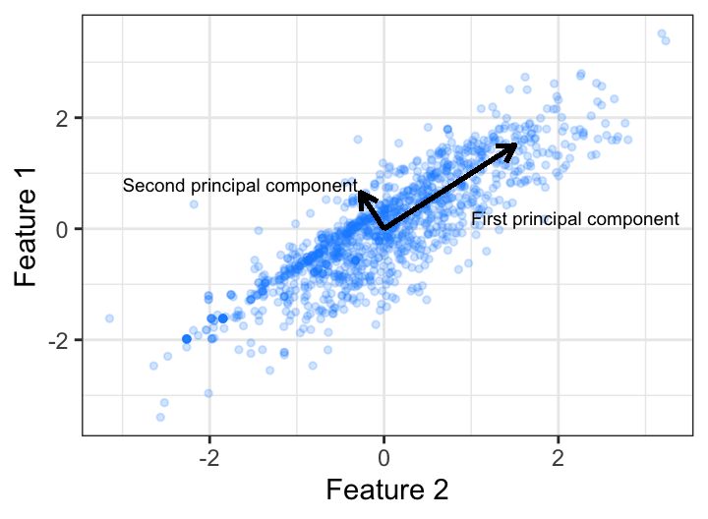
Principal Components
Dimension reduction
1. Plot n predictors in n-dimensional space
The dimension with the largest amount of variance is the first principal component, the orientation that accounts for the most variance in the data
2. Searches for the next greatest amount of variance orthogonal to PCA1
3. This continues until you have n principal components

Slide 3
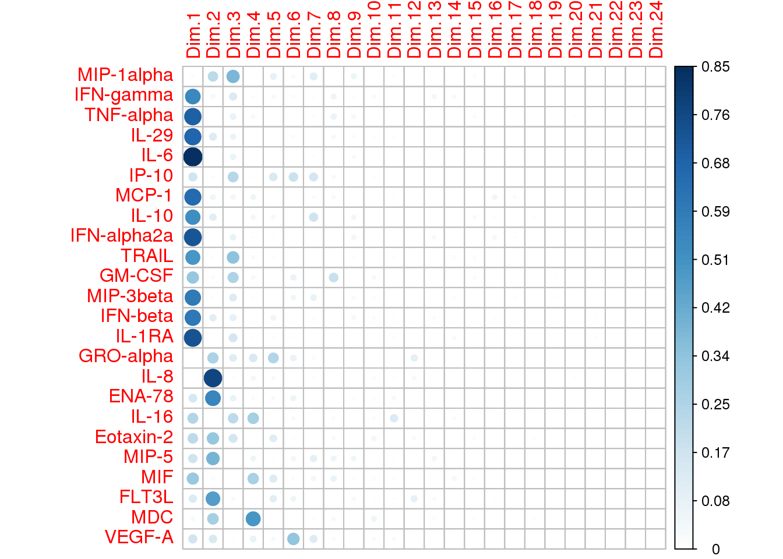
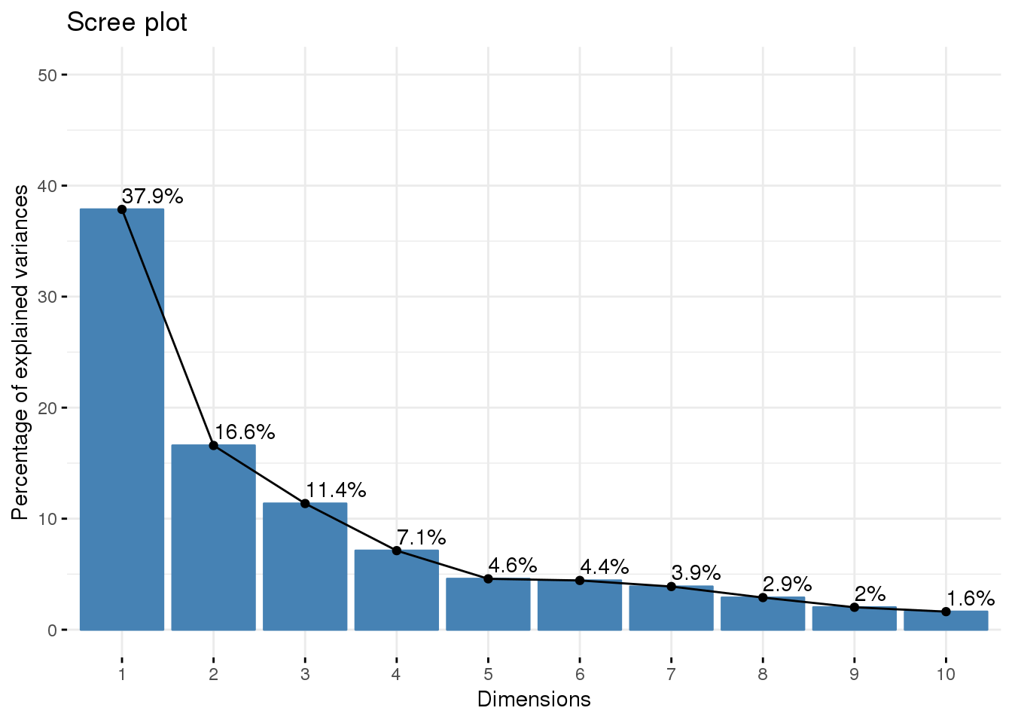
PCA Dimension Reduction

Slide 4
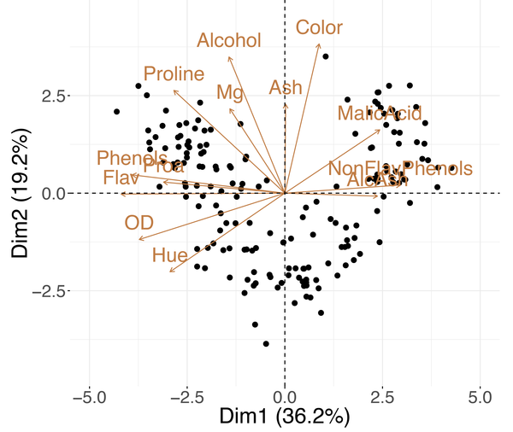
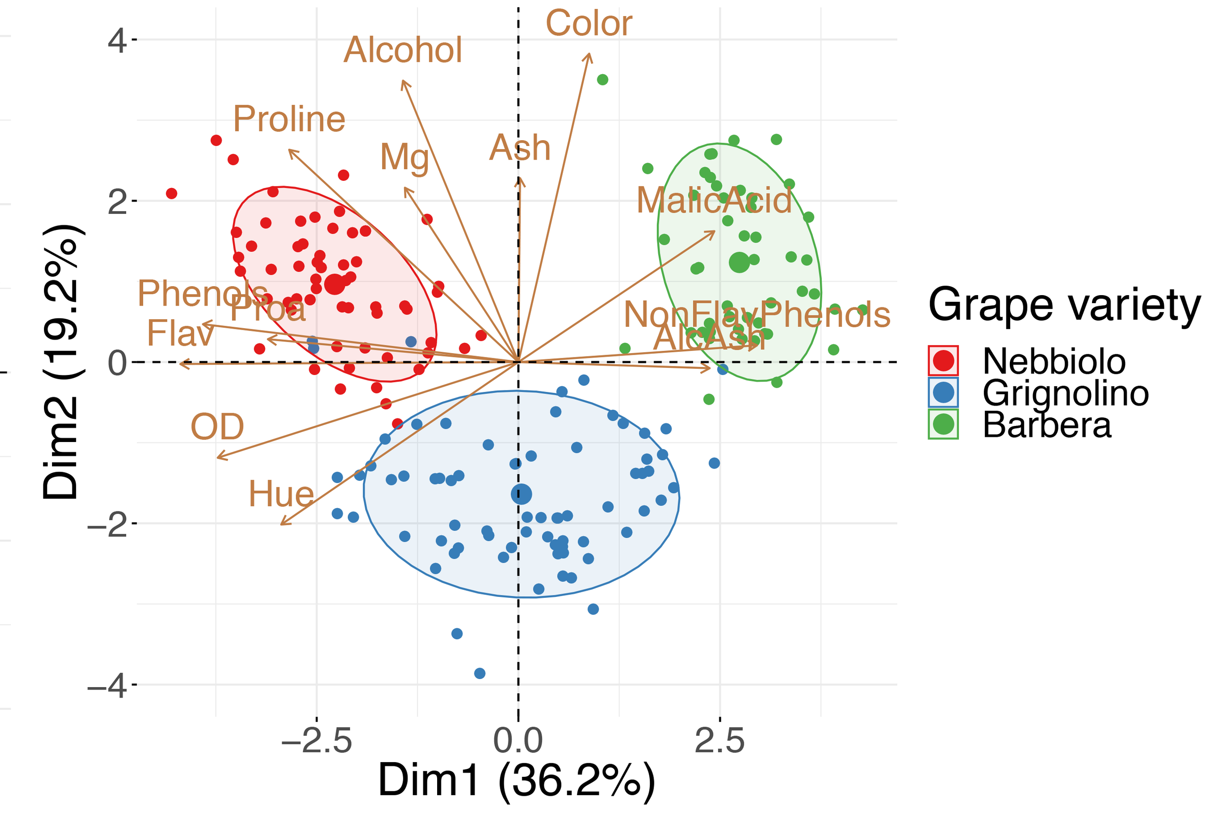
Toy Example, Grape Varieties

Slide 5
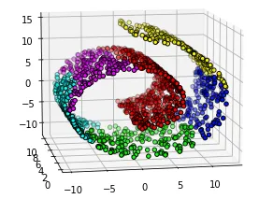
PCA
Good for preserving global structure
Can be used to convert data to components in PC regression
You can overlay defined group on PCA biplot to see (or not see) evidence of data-informed clusters
Fails for non-linear relationships and isn’t great for local relationships
https://newmortalbeing.medium.com/understanding-t-sne-d869ece441a5

Slide 6
t-SNE

Slide 7
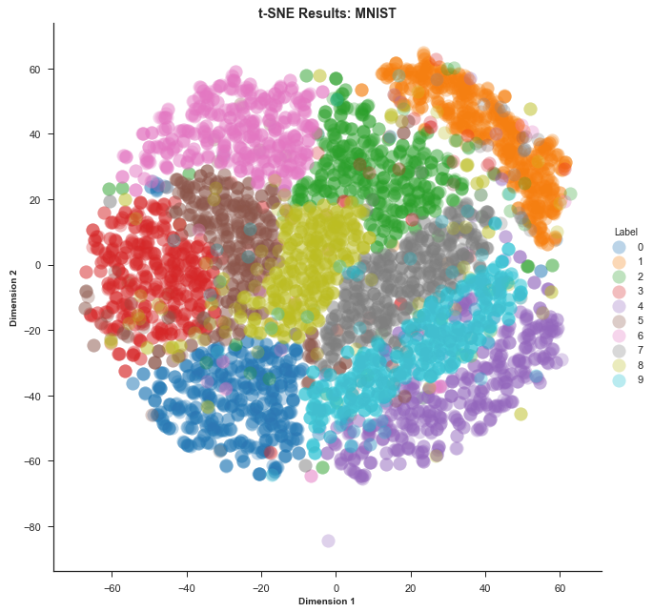
t-SNE
t-Distribution Stochastic Neighbor Embedding
Transforms high-dimensional data into low-dimensional data for easy visualization, especially with regard to clusters
https://distill.pub/2016/misread-tsne/
https://www.google.com/search?q=t-SNE+video&rlz=1C1GCEU_enUS943US943&oq=t-SNE+video&aqs=chrome..69i57j33i160.2089j0j7&sourceid=chrome&ie=UTF-8#fpstate=ive&vld=cid:6c22aa27,vid:NEaUSP4YerM

Slide 8
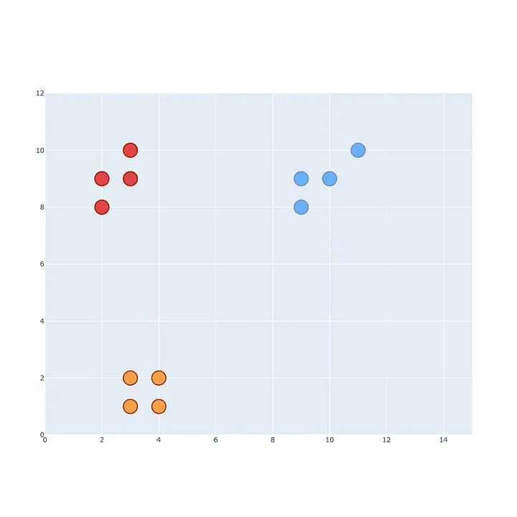
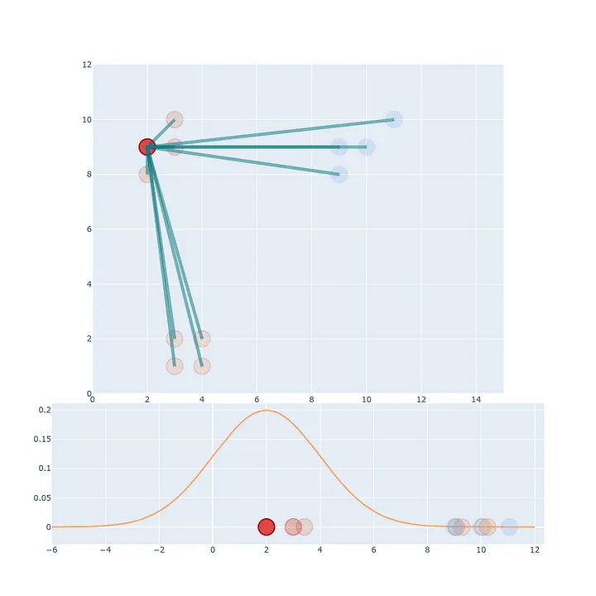
t-SNE step 1: The high-dimensional space
The distances of each point from x1 are scaled to sum to 1
https://towardsdatascience.com/t-sne-clearly-explained-d84c537f53a#:~:text=How%20t%2DSNE%20works%3F

Slide 9
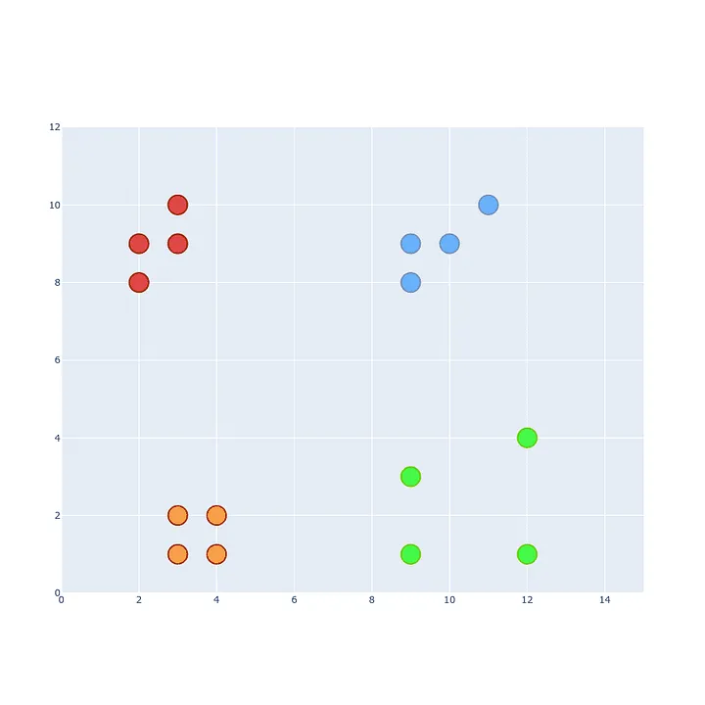
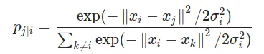
Each projection distance is scaled by the sum of all the projections
Makes everything sum to 1
Accounts for sparse vs. dense clusters

Slide 10
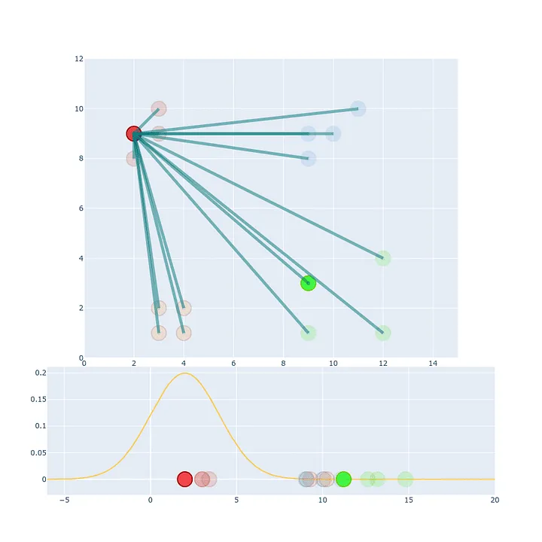
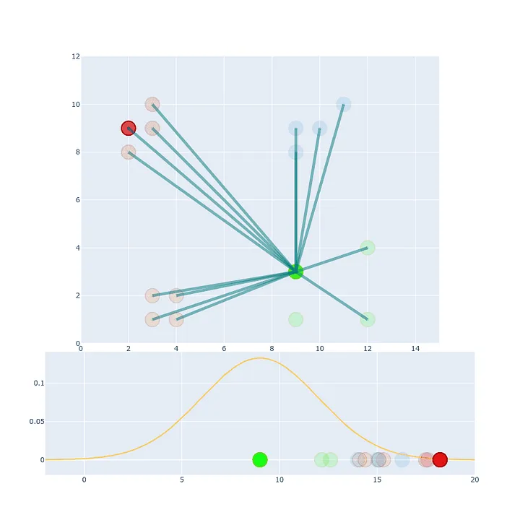
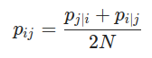
Averaging Distances
A -> B projection value might not be the same as the b -> projection value
This is solved by averaging

Slide 11
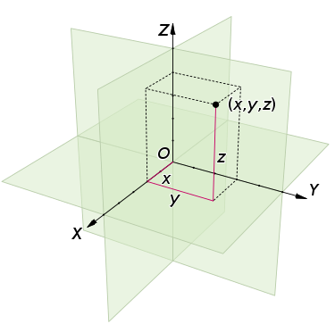
Euclidean Distance
Our points aren’t just in 2-D space, they’re in n-D space
How do you calculate the distance between two points in high dimensional space?

Slide 12
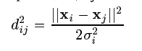
Euclidean Distance
$$ⅆ\left(x_{i},x_{j}\right)=\sqrt{{\left(x_{i1}−x_{j1}\right)}^{2}+{\left(x_{i2}−x_{j2}\right)}^{2}+…+{\left(x_{in}−x_{jn}\right)}^{2}}$$
 | a | b | c | d
a | 0 | 1 | 1 | 1
b | 1 | 0 | 0 | 1
c | 1 | 0 | 0 | 1
d | 1 | 0 | 1 | 0
 | a | b | c
b | 2
c | 1.732 | 1
d | 1.414 | 1.414 | 1.732
distance between the a and b columns:
a = (0, 1, 1, 1)
b = (1, 0, 0, 0)
d(a, b) = √[ (0-1)² + (1-0)² + (1-0)² + (1-0)²] = √4 = 2
distance between the a and b rows:
a = (0, 1, 1, 1)
b = (1, 0, 0, 1)
d(a, b) = √[ (0-1)² + (1-0)² + (1-0)² + (1-1)²] = √3 = 1.732
 | a | b | c
b | 1.732
c | 1.732 | 0
d | 1.732 | 1.414 | 1.414

Slide 13
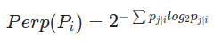
Perplexed?
Perplexity: A perplexity target number of neighbors for each x_{i}
Not the number of clusters, rather cluster size
Typical values between 5 and 50
Cannot be greater than your sample size!!
SNE is robust to changes in perplexity, meaning your choice is probably not too wrong
Shannon entropy/
Amount of “surprise”

Slide 14
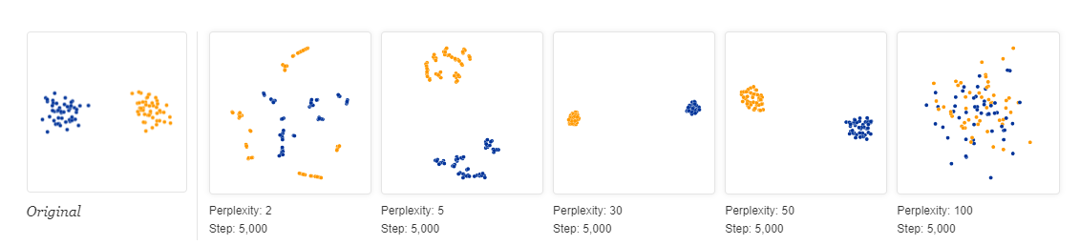
Impact of perplexity choice
How to choose perplexity?
Trial and Error
KNN rule of thumb – optimal K ~ sqrt(N)
30 seems to work well a lot
https://distill.pub/2016/misread-tsne/
https://towardsdatascience.com/how-to-tune-hyperparameters-of-tsne-7c0596a18868

Slide 15
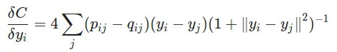
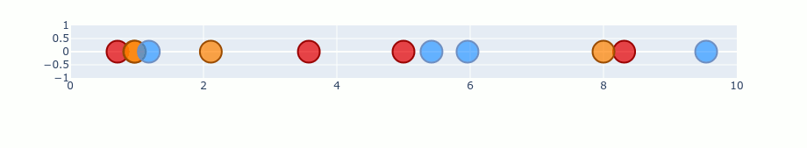
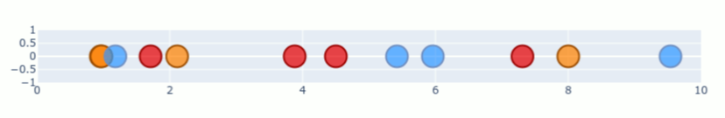
t-SNE: Stochastic Process & t-distribution
High-D space used Normal distribution but
that leads to crowding
Low-D space uses the t-distribution with 1 degree of freedom
Optimizing the match between the low and high dimensional space the Kullback-Leibler divergence (minimizes difference between the two)

Slide 16
UMAP

Slide 17
UMAP
Uniform Manifold Approximation and Projection
“At a high level, UMAP uses local manifold approximations and patches together their local fuzzy simplicial set representations to construct a topological representation of the high dimensional data”
https://pair-code.github.io/understanding-umap/#:~:text=UMAP%2C%20at%20its%20core%2C%20works,as%20structurally%20similar%20as%20possible.
https://www.google.com/search?q=umap+for+dummies&rlz=1C1GCEU_enUS943US943&oq=UMAP+for+dummies&aqs=chrome.0.0i512j0i390i650l2.5523j0j7&sourceid=chrome&ie=UTF-8#fpstate=ive&vld=cid:a3221e09,vid:6BPl81wGGP8

Slide 18
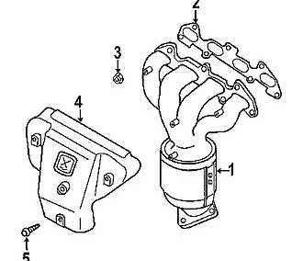
Manifolds
The word manifold comes from the Old English word manigfeald
from the Anglo-Saxon manig [many] and feald [fold]
refers to the folding together of multiple inputs and output
The exhaust manifold in your car collects the exhaust gases from multiple cylinders into one pipe
https://en.wikipedia.org/wiki/Exhaust_manifold

Slide 19
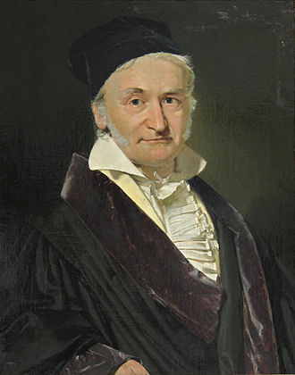
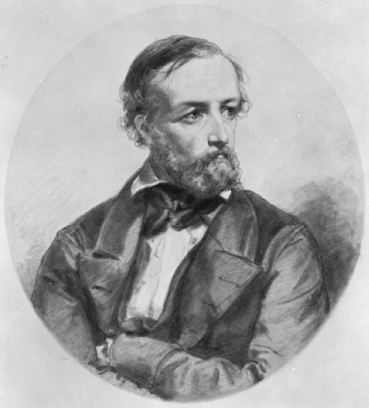
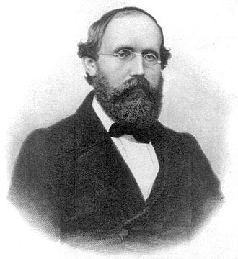
Riemann Manifold
Bernhard Riemann (1826-1866)
Studied with Johann Gauss and Johann Dirichlet
German mathematician who contributed to:
Pure math, prime number counting theory, complex numbers (i), Differential geometry, the best unsolved hypothesis ever, etc
Riemann integral (first complete calculus integral)
https://en.wikipedia.org/wiki/List_of_things_named_after_Bernhard_Riemann
Riemann Manifold
Combines topology and geometry to achieve data reduction

Slide 20
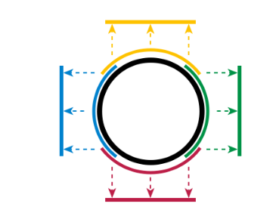
A circle can be simplified into a square
Charts
A circle is a 2-dimensional shape
Topology assumes curves and straight lines are the same things
The circle can be fully dived up into 4 equal/overlapping arcs than translate to lines (“Charts”)
All charts together describe the circle and are called an “Atlas”
The equation that connects the two is a “transition map”
Now the circle can be represented by multiple segments in 1-dimensional space
You can map a sphere to a disc, etc
https://en.wikipedia.org/wiki/Manifold

Slide 21
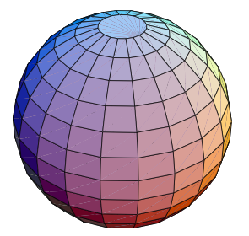
A 3D Example
“A manifold is a topological space that is locally Euclidean”
Around every point, there’s a neighborhood that that topologically “flat”
If you’re standing on a giant sphere, where you are might look flat
https://mathworld.wolfram.com/Manifold.html

Slide 22
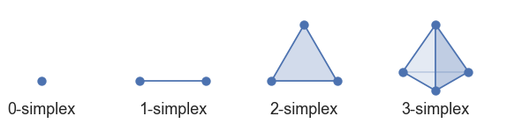
Simplexes
UMAP begins by building the topological space with simplexes
How to pick those simplexes?
Each data point gets a radius
Points with overlapping radii are lumped into same simplex

Slide 23
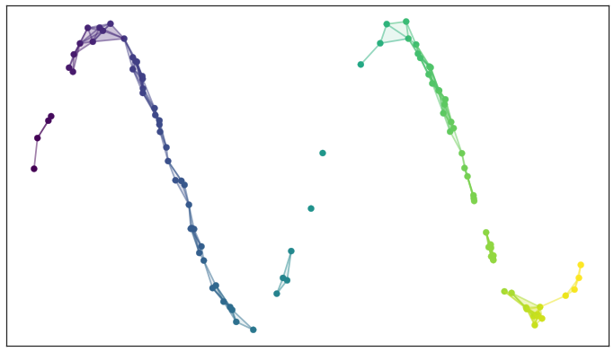
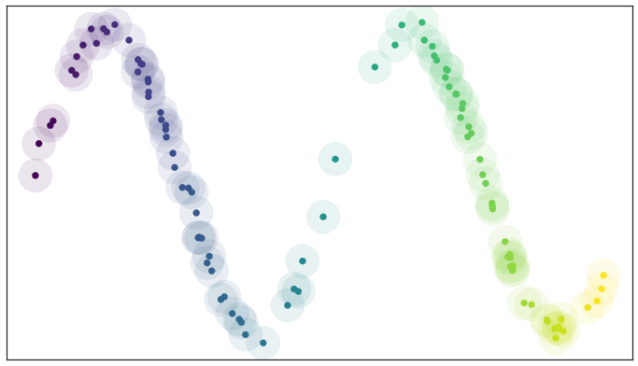
Simple simplex visualization

Slide 24
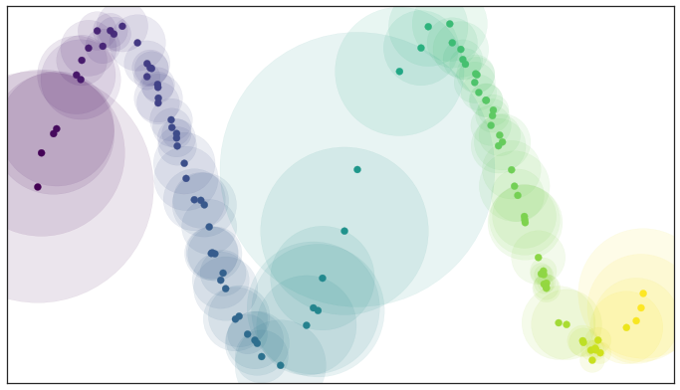
Radius size and variability
We can vary the radii for each point based on the number of neighbors we want each point to have – like perplexity in t-SNE

Slide 25
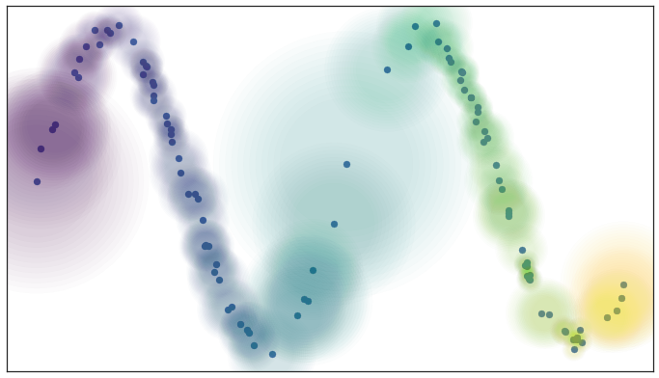
Fuzziness
The edges of our circles don’t have to be binary, yes/no
They can have a gradient probability between 0 and 1, where it’s higher closer to the point and lower further away

Slide 26
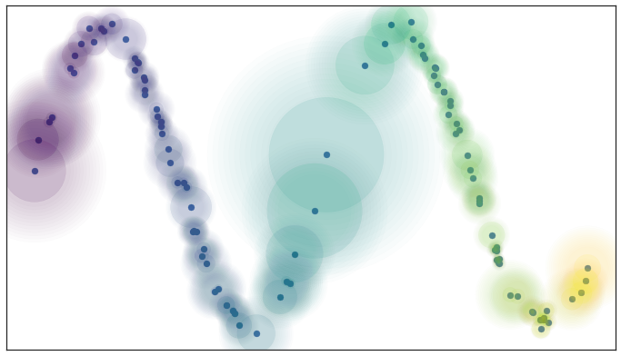
Local Connectivity
With just “fuzziness” there is the possibility that points could be isolated
It is a requirement that at any point on the manifold there is some sufficiently small neighborhood of the point that is connected

Slide 27
Resolving Disagreements
Fuzziness and local connectivity can end up creating simplexes that disagree with each other, especially with weighted edges
In t-SNE, we just averaged the Euclidean distances
In the world of fuzzy simplicial sets, you just take the fuzzy union
To merge two disagreeing edges with weight a and b then we should have a single edge with combined weight a+ b – a · b
This is the equation for joint probability
Weights are the probabilities that a connection between two points (“edge”) exists. The combined weight is then the probability that it exists.

Slide 28
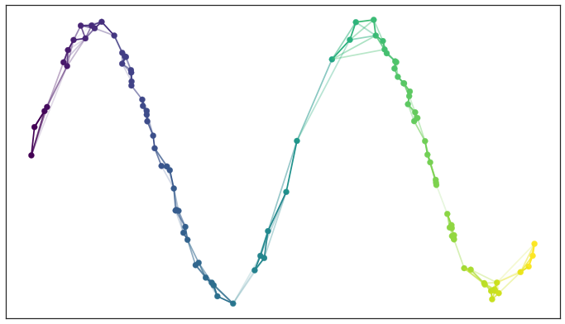

Slide 29
Creating and connecting the low-dimensional representation
Unlike step 1, the distance on the manifold needs to be a standard (Euclidean or otherwise) distance, not a varying radius
The nearest neighbor in step 1 needs to be globally true across the high and low manifolds as we optimize
Both the high and low dimensional structures share the same 0-simplices (single points), so we can do a neat trick:
We have probabilities of each 1-simplex (single edge) simply existing
That means we have two vectors of probabilities that are Bernoulli variables
That let’s us use Cross-Entropy as a cost function to match up the low-dimensional graph to the high dimensional data

Slide 30
Cross-entropy importance
Attractive force when there are large weights
Repulsive force weights are small
This has nicer features that the KL-divergence and means that both local and global features are maintained.
https://towardsdatascience.com/how-exactly-umap-works-13e3040e1668

Slide 31
PCA vs t-SNE vs UMAP
Characteristic | PCA | t-SNE | UMAP
Speed | Fast and computationally cheap | Slow | Fast-ish
Pros | Reasonably intuitive Good for linear relationships | Good with neighborhood definition, handles non-linearity | Good in illustrating local relationships while preserving global structure
Cons | Bad with outliers, cannot see non-linear clusters | Globally ok, but distance between final clusters is not meaningful, hyperparameter setting can be confusing/wrong | Requires hyperparameters, non-deterministic (repeated UMAPs won’t look the same)
https://towardsdatascience.com/dimensionality-reduction-for-data-visualization-pca-vs-tsne-vs-umap-be4aa7b1cb29

Slide 32
Comparing t-SNE and UMAP
Live Demo
https://pair-code.github.io/understanding-umap/#:~:text=UMAP%2C%20at%20its%20core%2C%20works,as%20structurally%20similar%20as%20possible.

Slide 33
Heatmaps

Slide 34
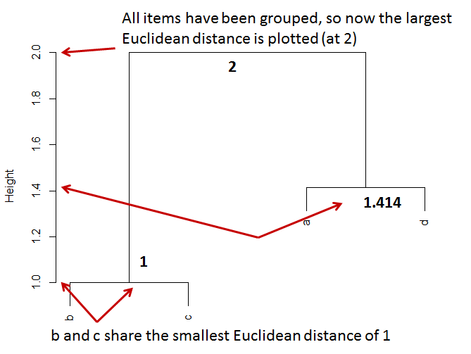
Data Viz and Clustering: Dendrograms
Remember Euclidean Distances?
Start from the bottom up, plotting the smallest distance first
b and c have the smallest distance at 1.
The next smallest distance is 1.414, shared by both b and d and a and d, but b is already grouped with c,
So a and d are plotted.
All items have been grouped so the highest Euclidean distance (2 in this case) is plotted to connect the two groups.
 | a | b | c
b | 2
c | 1.732 | 1
d | 1.414 | 1.414 | 1.732

Slide 35
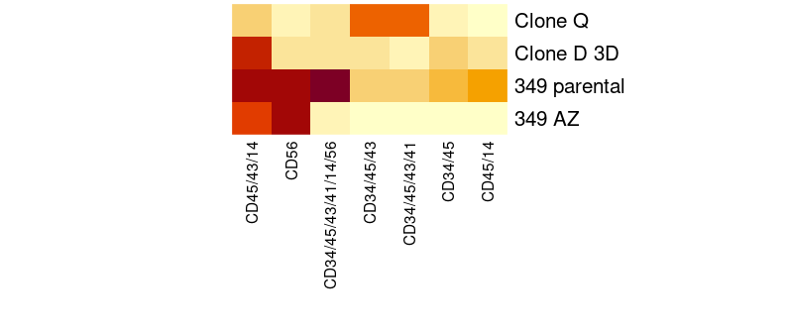
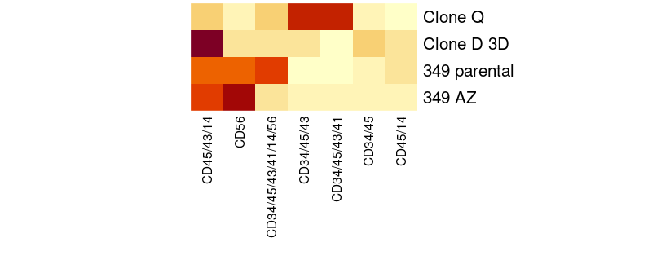
Heatmaps
Centering and scaling is almost often required to put samples/subjects on the same footing
These are effectively z-scores (subtract the mean, divide by SD)

Slide 36
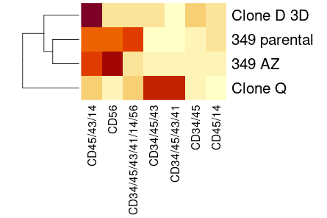
Heatmaps and Dendrograms
Agglomerative clustering on the direction of interest (in this case, the rows) informs the dendrogram
Because we are comparing vectors, we use Euclidean distance
There are a few different algorithms
With small samples, very little difference
We can interpret this clustering of the heatmap as which clones behave more like each other

Slide 37
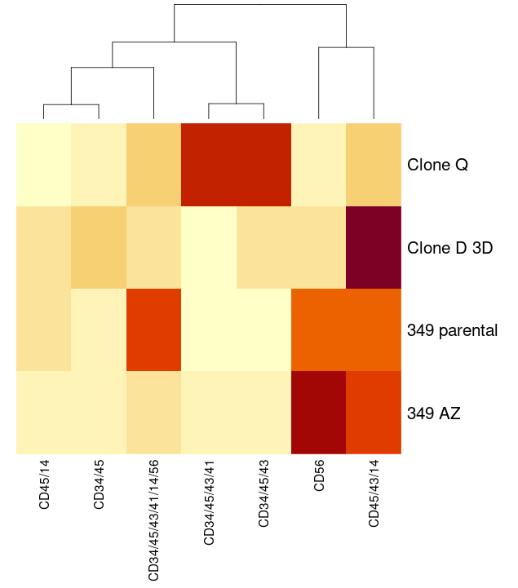
Heatmaps and Dendrograms
We can also cluster in the column direction and see which cell types are most similar across clones
We could also look at both simultanously

Slide 38
More Topics

Slide 39
Automated Gating
Automated gating
FlowJo plug-in EZ-DAFI
Shiny app by Pharmalex
Statistician concerns
Operator error/bias
Quality of the automated gating algorithm
Discuss?

Slide 40
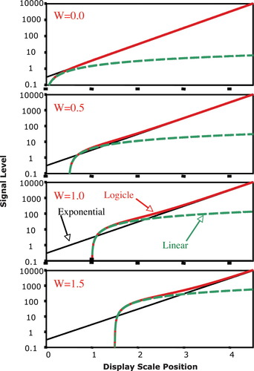
Data transformation in FlowJo
Log-transformation: log(x)
pros: historical, intuitive, easy
cons: can’t handle 0 and negative values, piles low values up close to 0
Bi-exponential / “logicle”:
S(a, b, c, d, f) = ae^{bx} - ce^{dx} +f
based on the hyperbolic sine function, linear near 0
Sinh(x) = (e^{x} – e^{-x})/2
5 parameters are fixed and represent:
Max data value in displayed scale (T)
Range of display in relation to width of high data value decades (M, m)
Strength and range of linearization around 0 (W, w)
Range of negative values to be included

Slide 41
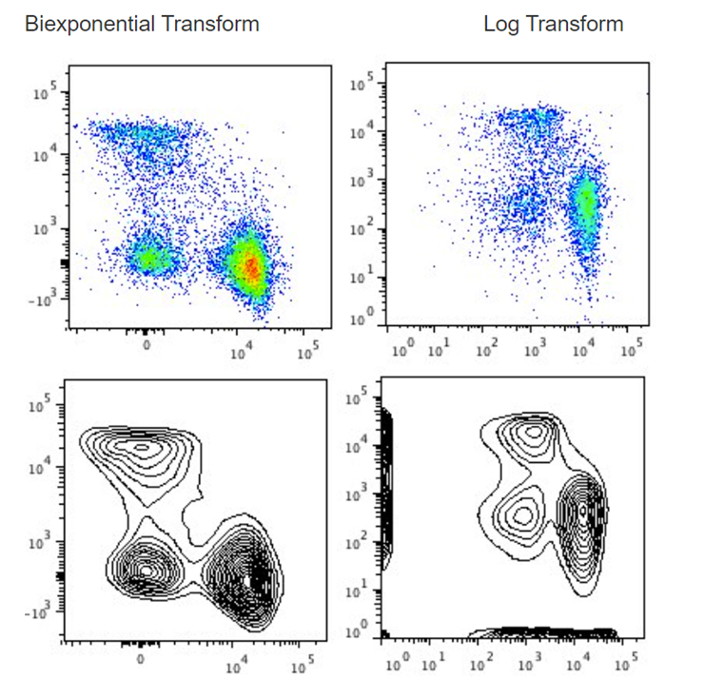
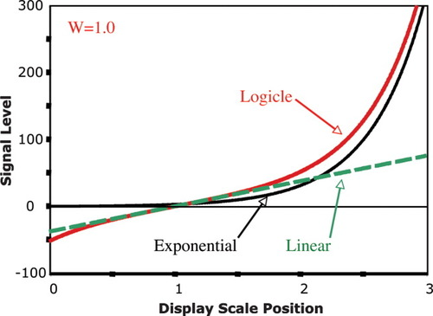
Bi-ex vs. Log

Slide 42
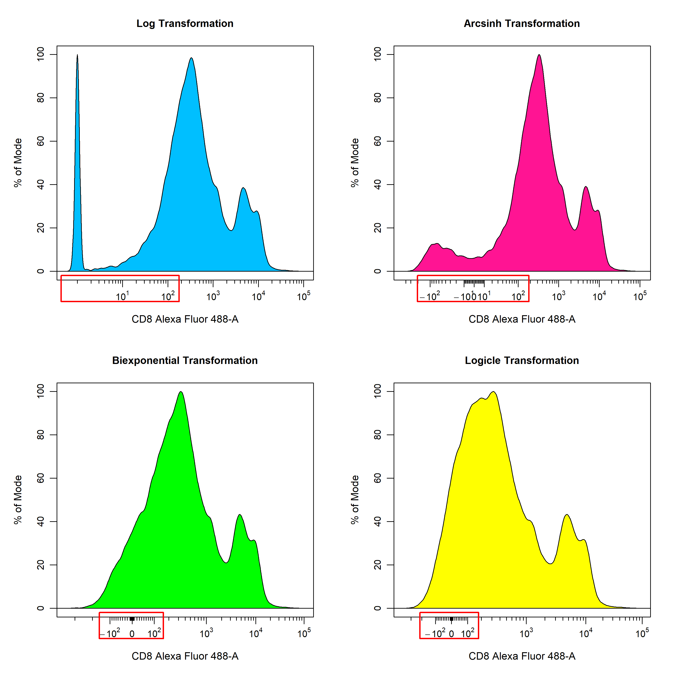
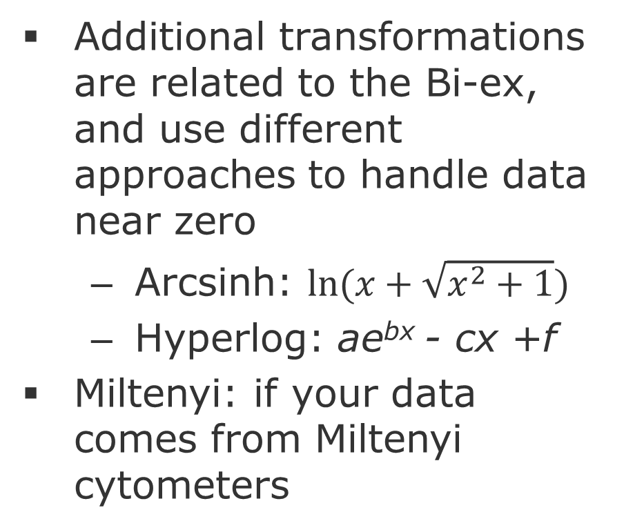
Other transformations
Additional transformations are related to the Bi-ex, and use different approaches to handle data near zero
Arcsinh: $ln⁡(x+\sqrt{x^{2}+1})$
Hyperlog: ae^{bx} - cx +f
Miltenyi: if your data comes from Miltenyi cytometers

Slide 43
Events and power
Topic for further discussion
Typically, we think of power as sample size, i.e., number of samples or subjects
Thinking about a number of events that constitute a “real” signal within a single sample requires discussion around
Probability distribution of data
Sensitivity around assay, assay validation concepts

Slide 44
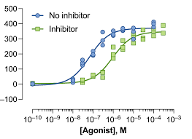
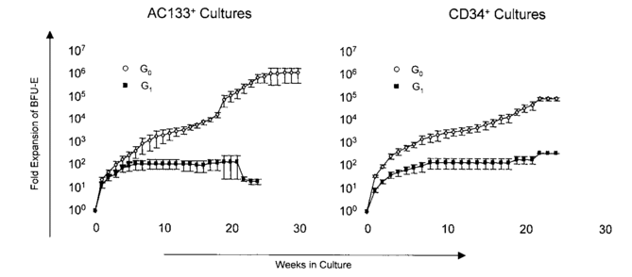
Dose Response / Fold Expansion
Topic for further discussion

Slide 45
Sources
Comparing UMAP vs t-SNE in Single-cell RNA-Seq Data Visualization, Simply Explained https://blog.bioturing.com/2022/01/14/umap-vs-t-sne-single-cell-rna-seq-data-visualization/
Dimensionality Reduction for Data Visualization: PCA vs TSNE vs UMAP vs LDA https://towardsdatascience.com/dimensionality-reduction-for-data-visualization-pca-vs-tsne-vs-umap-be4aa7b1cb29
Dimension Reduction PCA, tSNE, UMAP, Integration https://www.bioinformatics.babraham.ac.uk/training/10XRNASeq/Dimension%20Reduction.pdf
UMAP: Uniform Manifold Approximation and Projection for Dimension Reduction https://arxiv.org/pdf/1802.03426.pdf
Understanding t-SNE https://newmortalbeing.medium.com/understanding-t-sne-d869ece441a5
Stochastic Neighbor Embedding https://cs.nyu.edu/~roweis/papers/sne_final.pdf
How to Use t-SNE Effectively https://distill.pub/2016/misread-tsne/
Understanding UMAP https://pair-code.github.io/understanding-umap/#:~:text=UMAP%2C%20at%20its%20core%2C%20works,as%20structurally%20similar%20as%20possible.
UMAP clearly explained https://medium.com/@zahraelhamraoui1997/umap-clearly-explained-6324711c855b
The Beginner’s Guide to Dimensionality Reduction https://dimensionality-reduction-293e465c2a3443e8941b016d.vercel.app/
Data Transformation (FlowJo) https://docs.flowjo.com/flowjo/graphs-and-gating/gw-transform-overview/
A new "Logicle" display method avoids deceptive effects of logarithmic scaling for low signals and compensated data
https://pubmed.ncbi.nlm.nih.gov/16604519/
Data Transformations https://dillonhammill.github.io/CytoExploreR/articles/CytoExploreR-Transformations.html#arcsinh-transformation-1

